Slide 1

Dongguan Depu Energy Technology Co., Ltd.

Slide 2
Contents
01 Company Introduction
02 Products and service
03 Customers
04 R&D

Slide 3
Company Introduction
Founded in 2019, Dongguan Depu Energy Technology Co., Ltd is a comprehensive company that integrats R&D, production, sales of global smart new energy products and energy-saving systems. We have setup an office in Munich, Germany. Our products include energy storage system, and photovoltaic, storage and charging integrated products and solutions. The R&D team has many years of experience in the field motive battery, energy storage system and power supply industry. We are also capable of developing power modules (ACDC, DCDC), battery management systems (BMS), EMS, and charging systems.

Slide 4
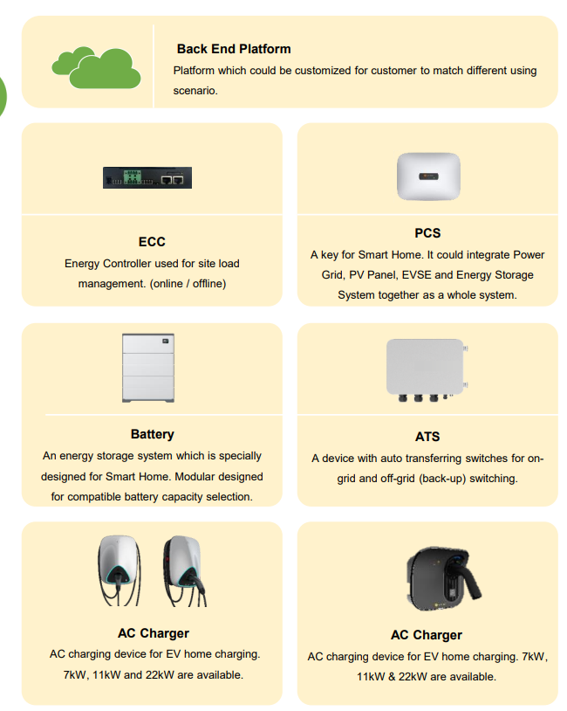
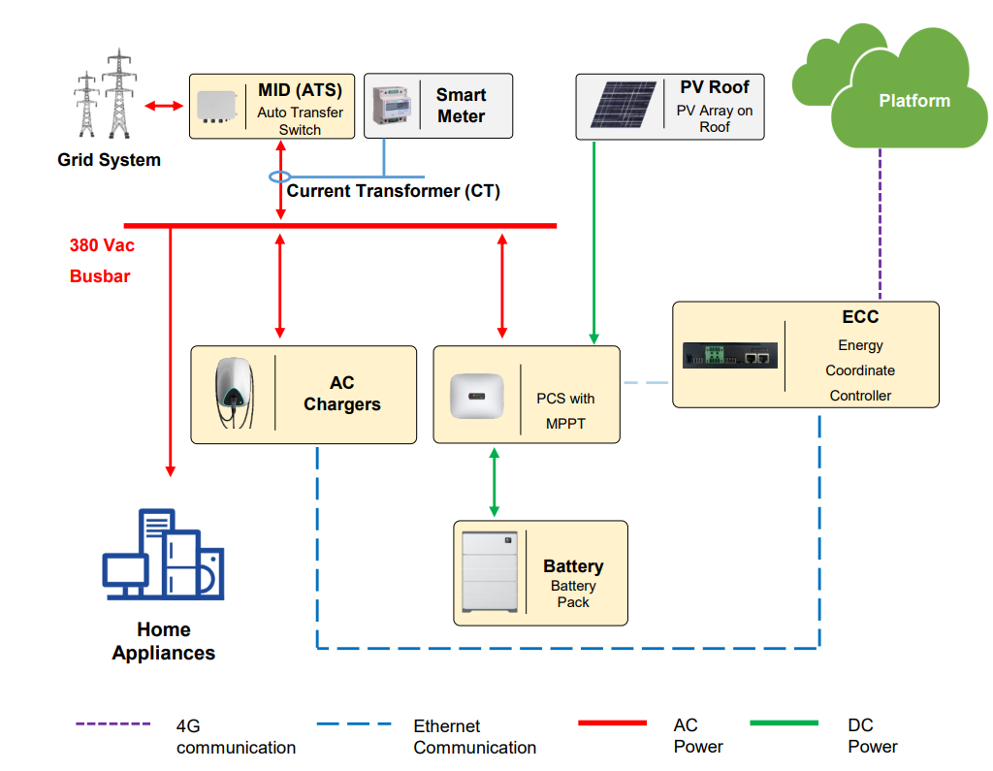
The architecture of residential photovoltaic, storage and charging solution

Slide 5
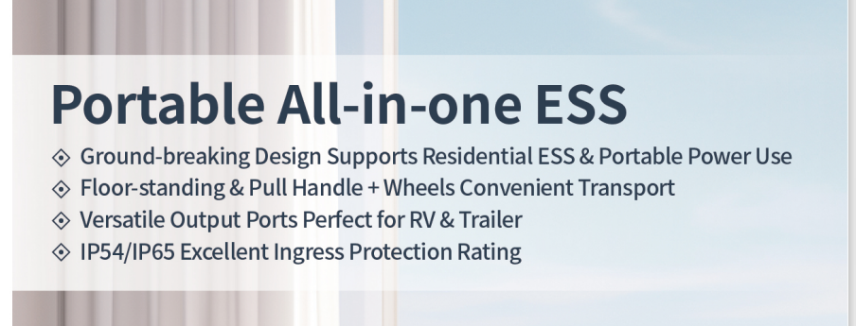
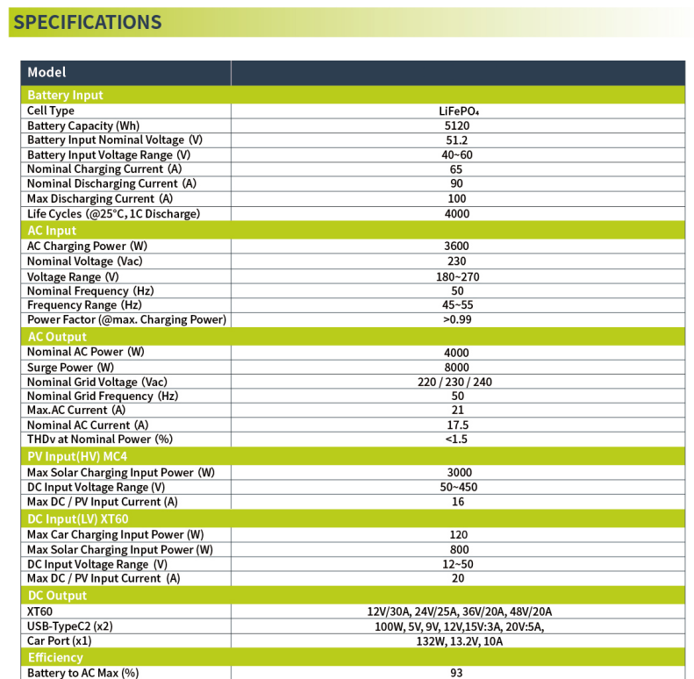
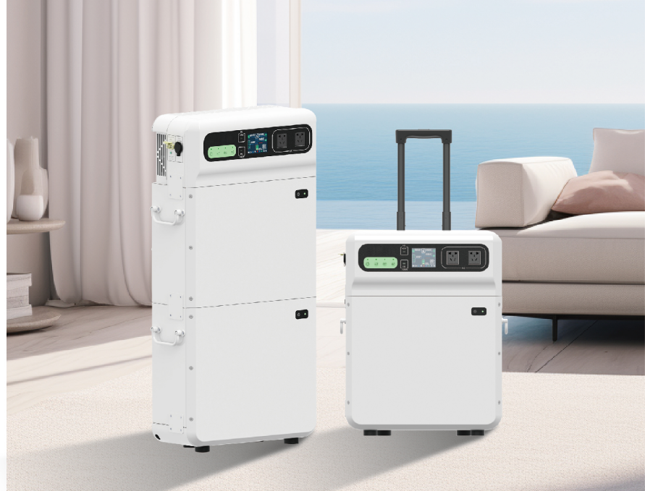
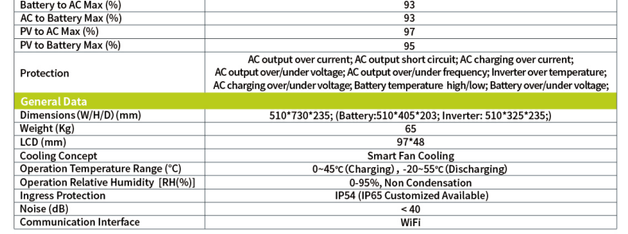
Portable All-in-one ESS

Slide 6
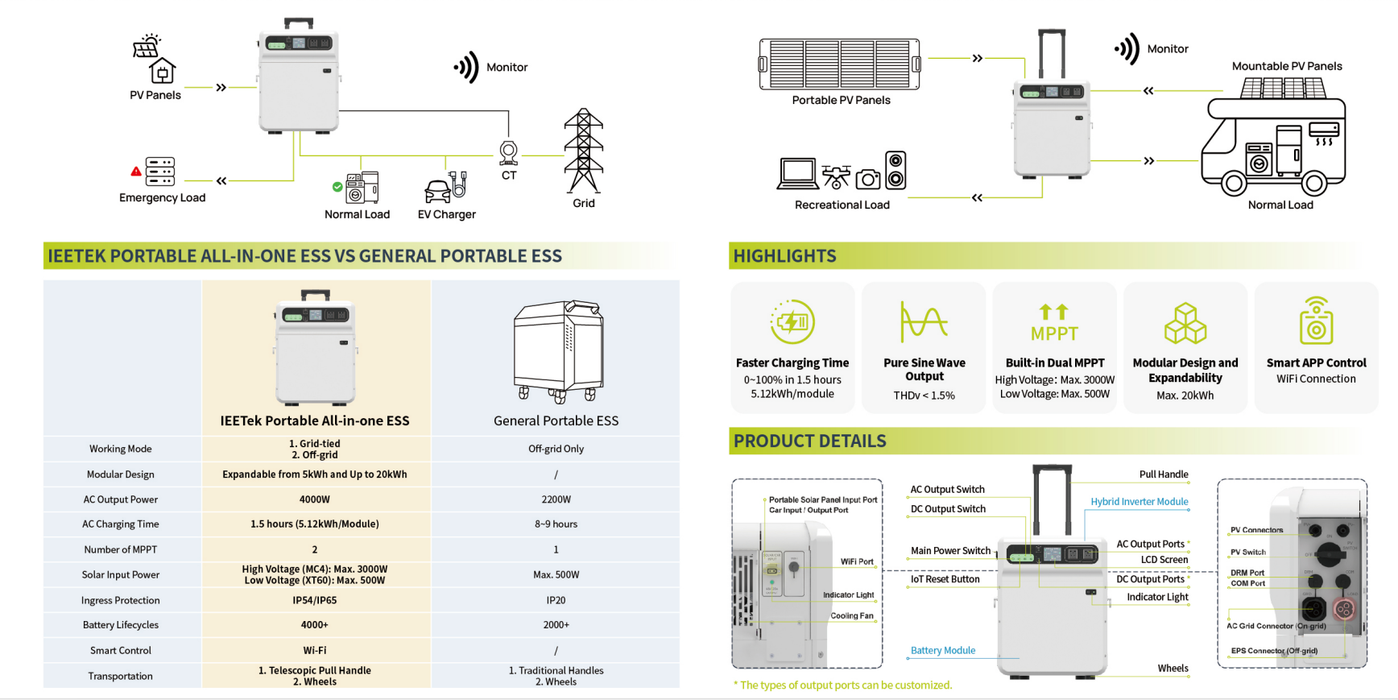
Portable All-in-one ESS

Slide 7
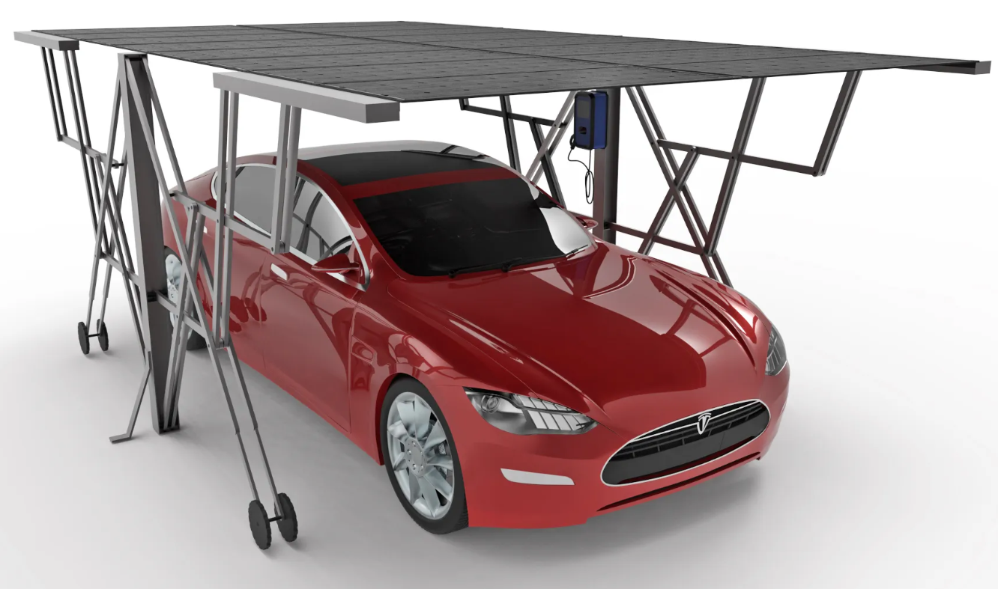
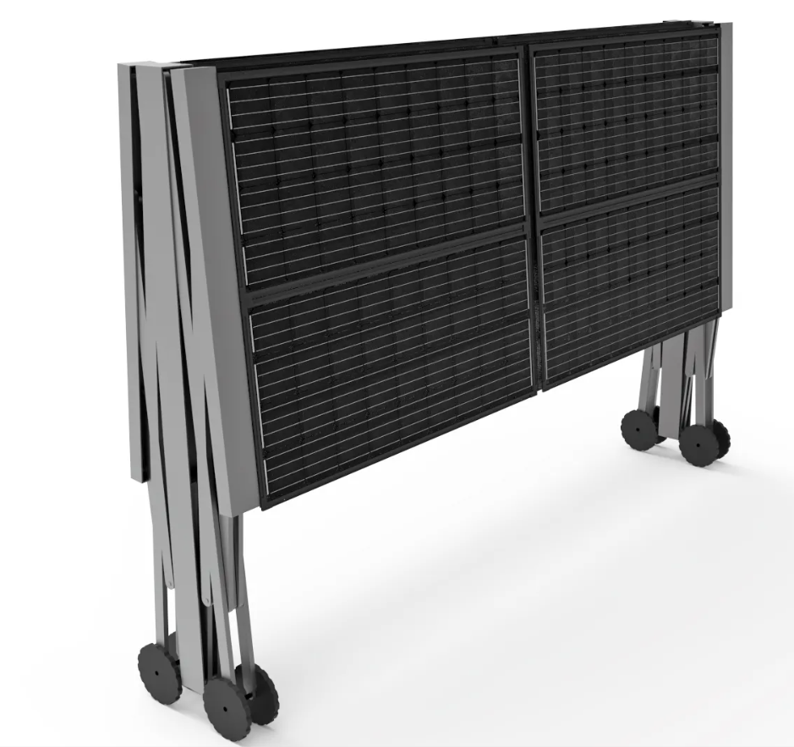
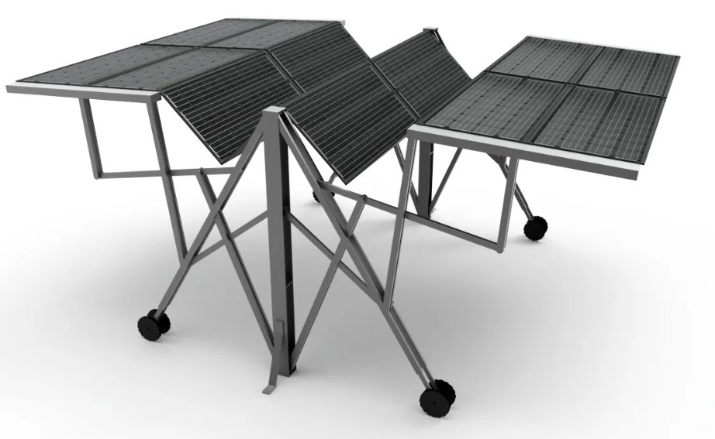
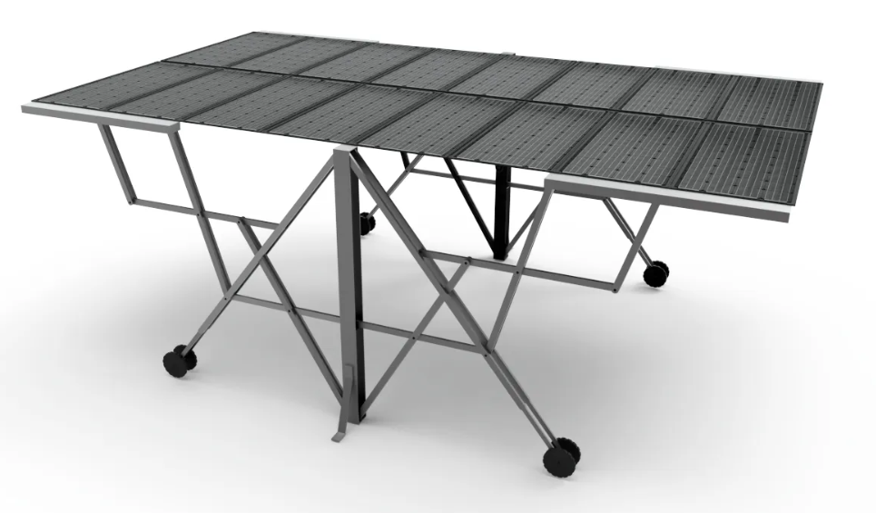
Foldable solar carport
Solar foldable carport
The carport consists of top foldable PV bracket, the supporting foldable frame bracket and foldable supporting board.
Top foldable PV bracket:
Adopting modular design, each is composed of independent photovoltaic power generation units, which can be flexibly disassembled according to actual needs.
Supporting foldable frame bracket：
Aluminum make it much light while ensuring its strength.
Foldable supporting board:
When folding, the size is:L1500*W400*H2100mm. After unfolding, the size is consistent with the size of the standard parking space, the wind resistance level can be increased with the help of the car's own weight.

Slide 8
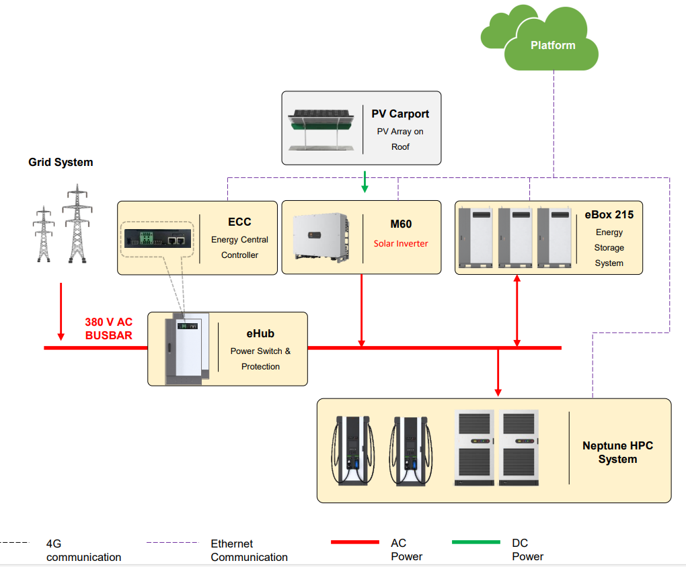
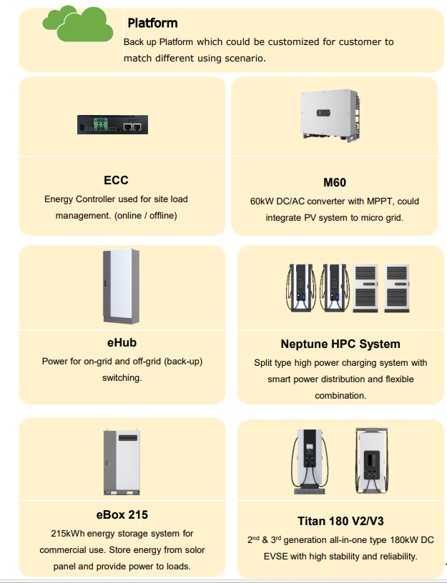
The architecture of C&I photovoltaic, storage and charging solution

Slide 9
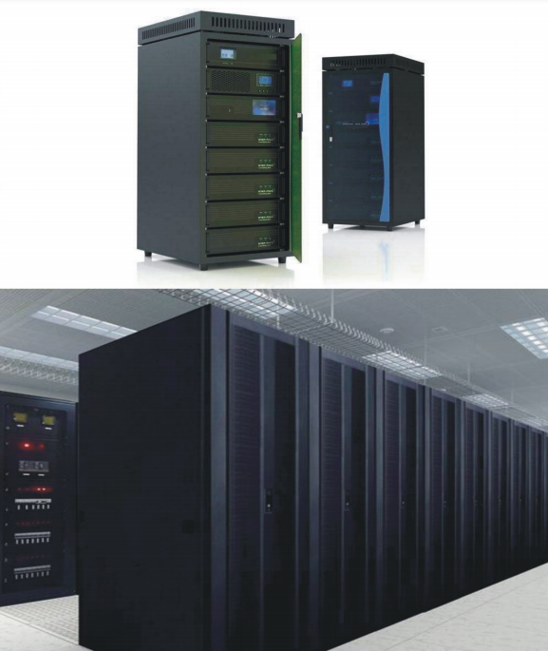
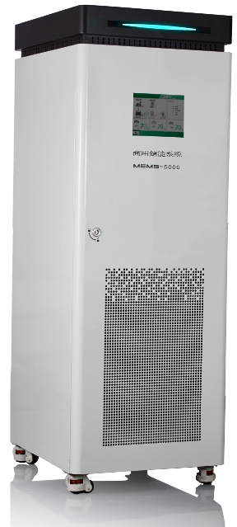
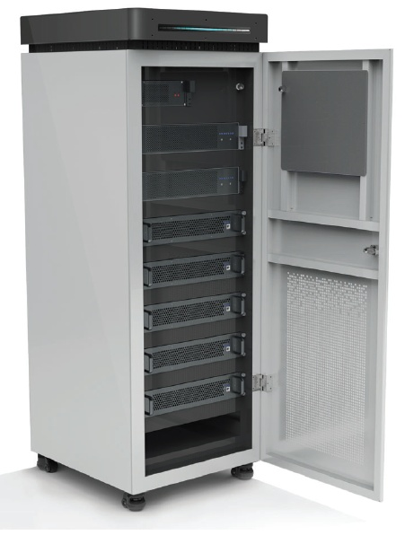

Products and application
Traditional telecom, data centers, and large shopping malls apply lead-acid batteries for backup power supply. Driven by the trend of environmental protection, a lot of them are now using clean new renewable energy as the power source. The use of safe and environmental-friendly lithium iron phosphate battery has become a good option.

Slide 10
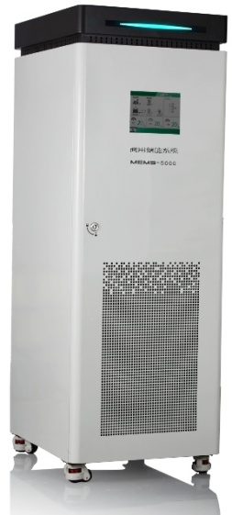
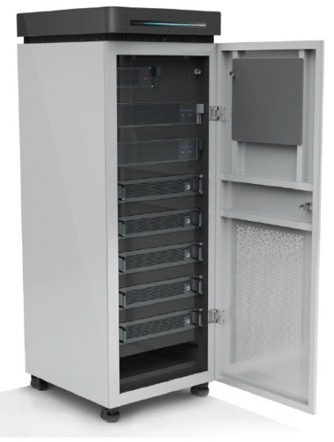
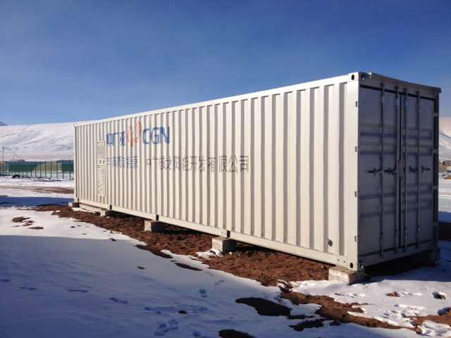
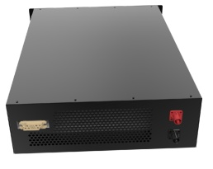
Energy storage products and application
48V Series
Energy storage cabinet
Containerized energy storage system

Slide 11
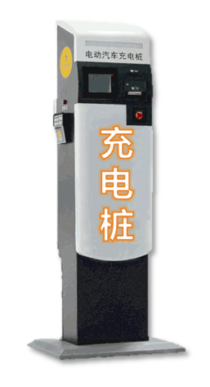




Smart charging products and application
Charging pile
Grid
Ev
Charging
Charging
放电
放电

Slide 12
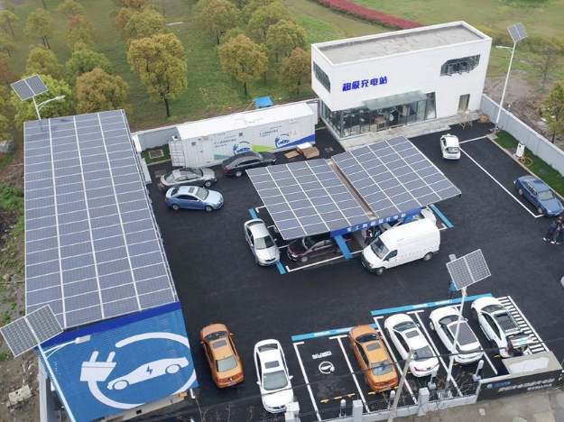
Photovoltaic, storage and charging station
1
PV power generation serve as the main power source
2
Energy storage application: peak shaving
3
No fee for charging service
4
Charging price is lower than the price of peak and usual hours

Slide 13
～Thanks～

